Slide 1
Project Presentation

Slide 4
Variable Correlation

Slide 5
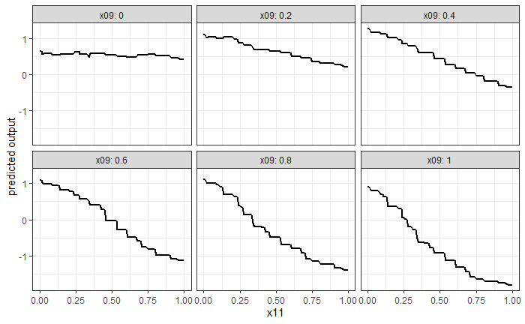
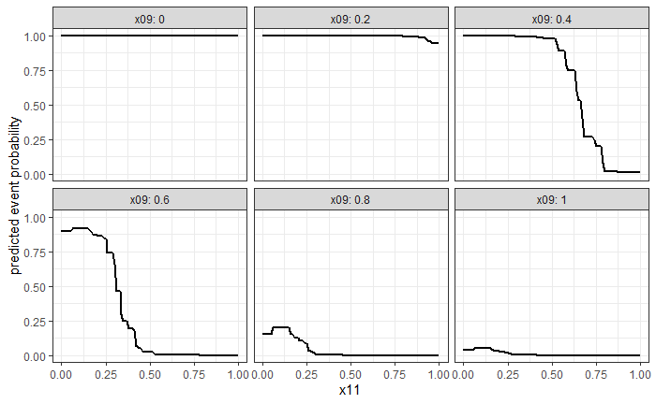
Best-Performing Model – X Variables
Continuous Output (Regression)
Event Probability (Classification)
Model fitted using gradient-boosted tree.

Slide 6
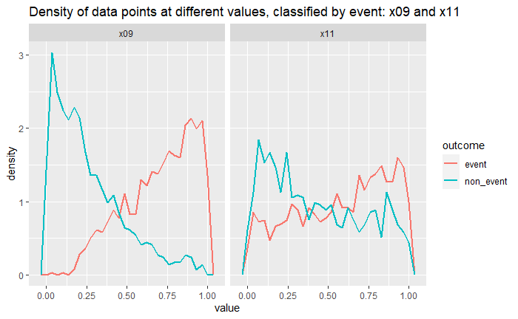
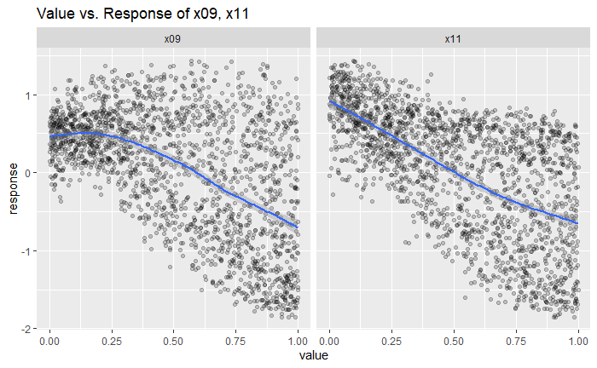
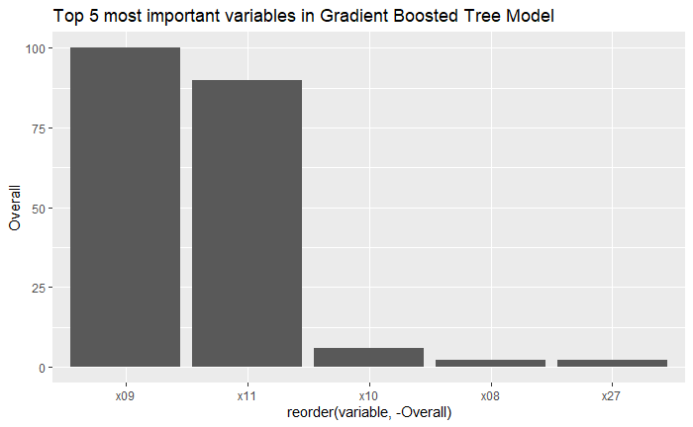
Variable Importance – X Variables
X09 and x11 consistently found to be most important variables
All other variables have marginal importance to model.
Importance of X09 and X11 consistently found across different models.

Slide 7
Best Performing Model – V Variables
Gradient-Boosted tree maximized Accuracy
Random Forest maximized ROC scores

Slide 8
Variable Importance – V Variables

Slide 9
Performance on Holdout Set

